Slide 1

Android
Basics

Slide 2

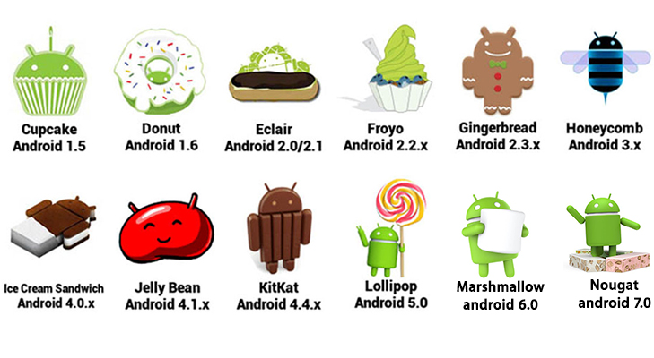
General Facts
OS for mobile devices (Smartphones, Tablets, Smartwatches, etc)
Based on Linux
Developed by the Open Handset Alliance led by Google
Oreo
Android 8.0

Slide 3
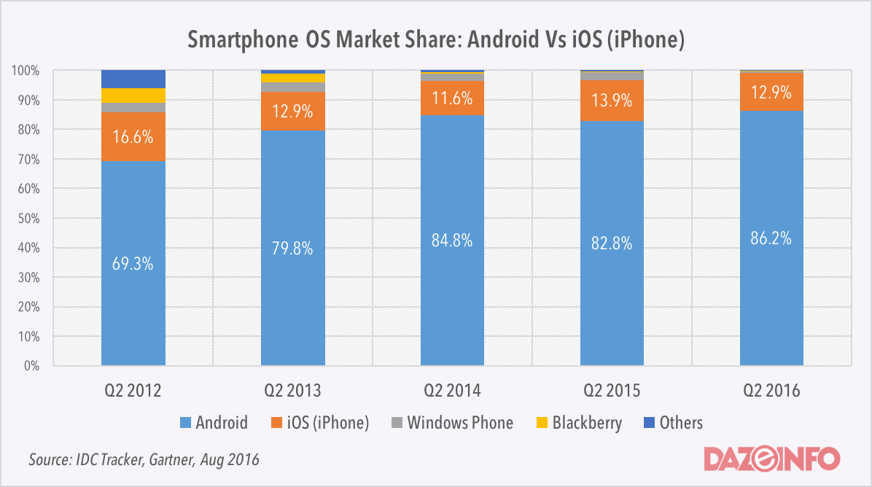
General Facts

Slide 4
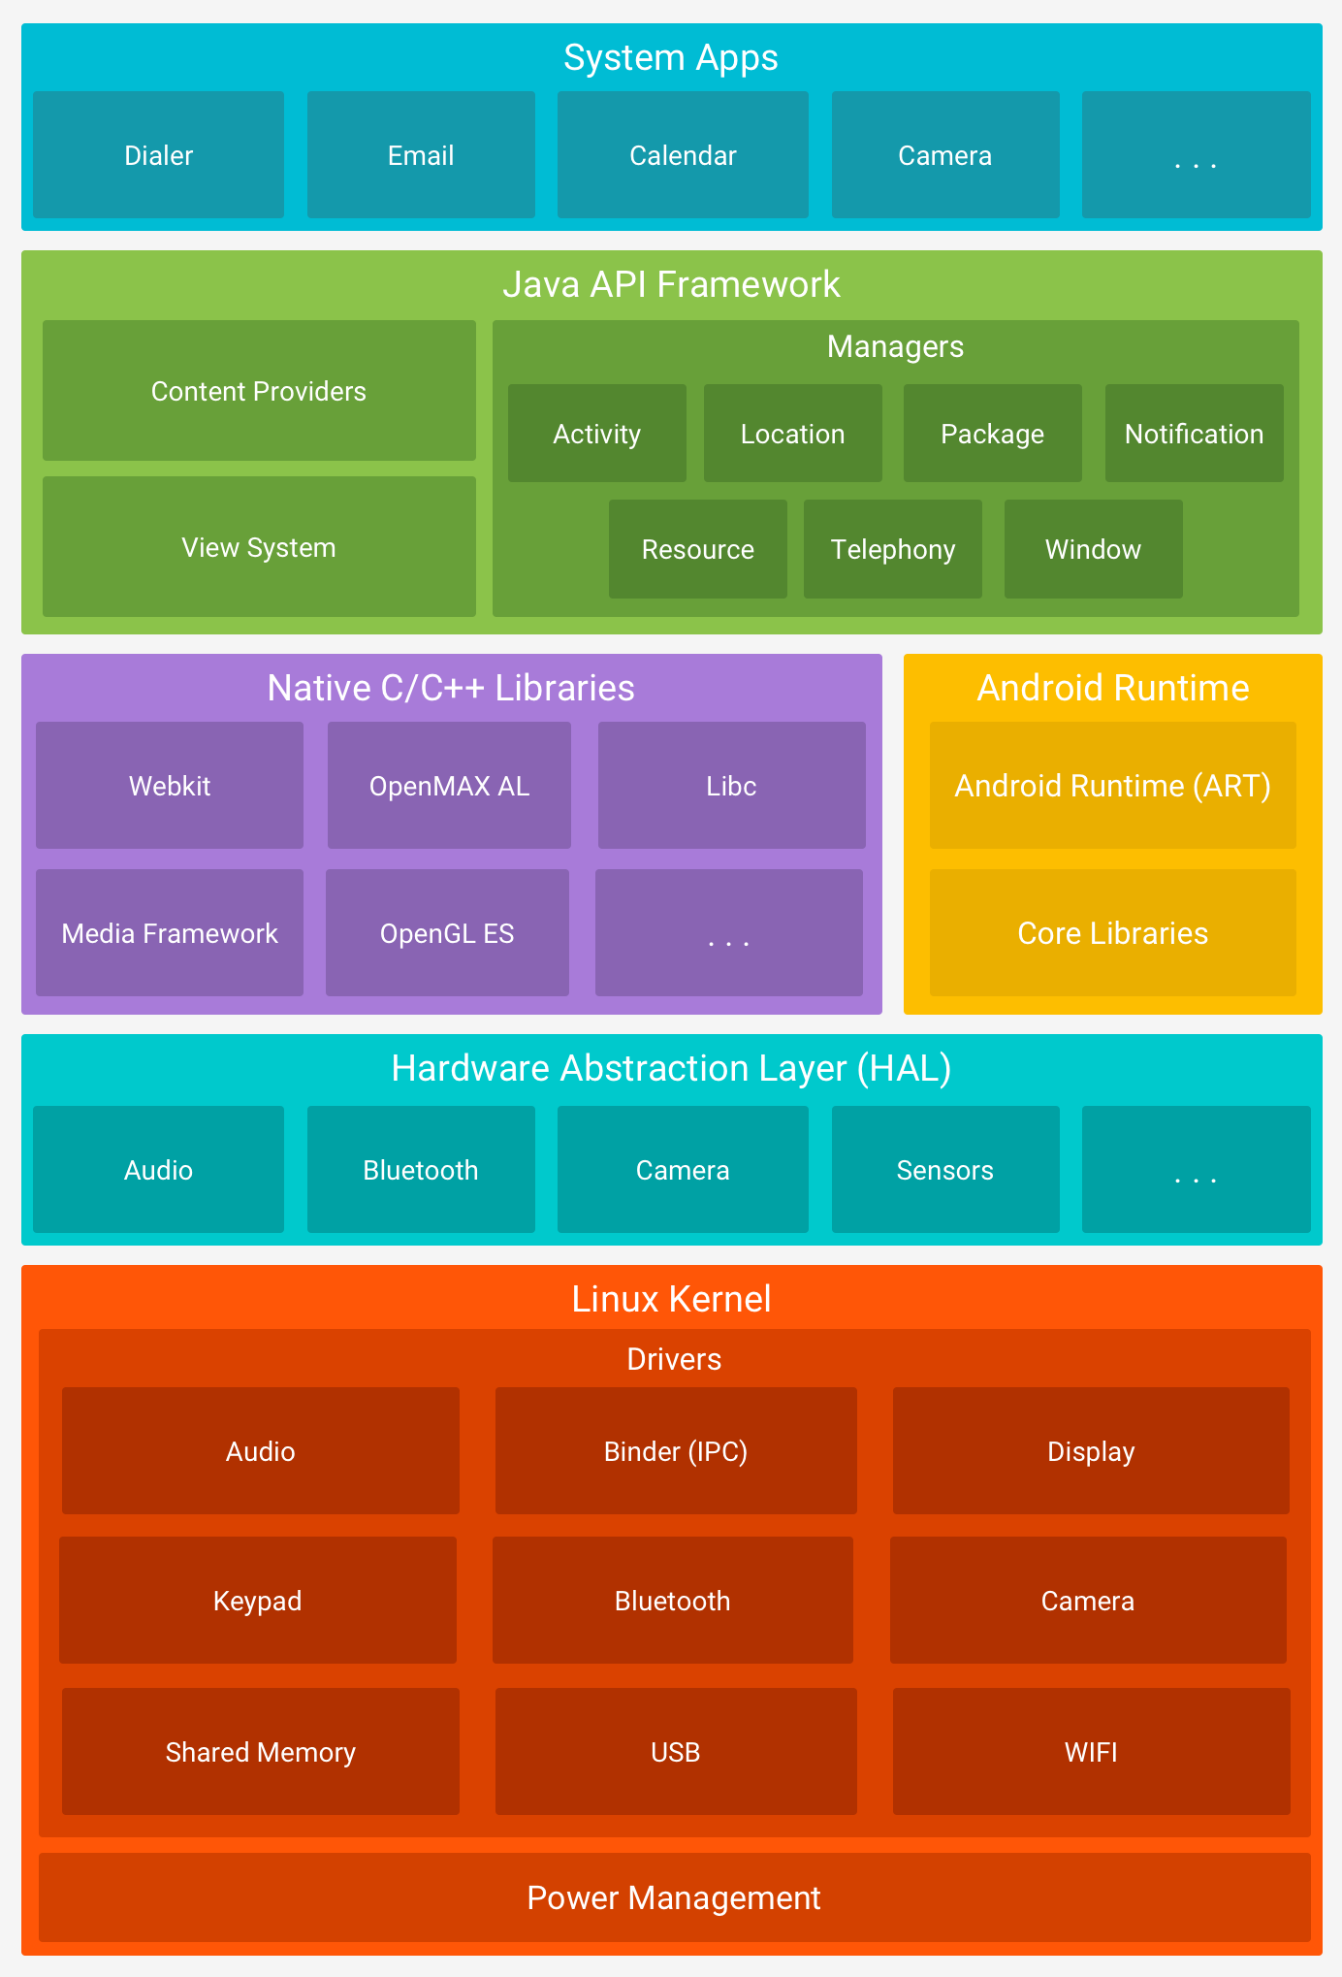
Platform Architecture

Slide 5
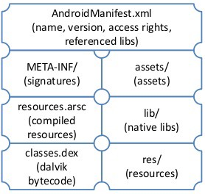
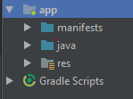
Application Architecture
APK Structure
Project in Android Studio
Android Manifest
Source Code
Resources

Slide 6
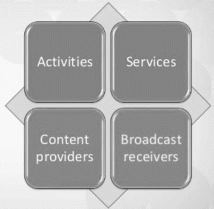
Application Components

Slide 7
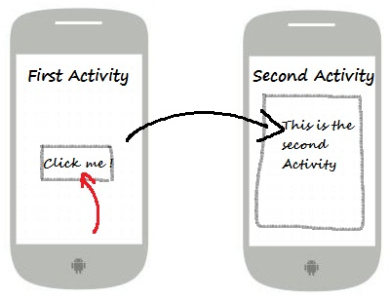
Activity
Represents a single Screen
An app consists of multiple Activites
Every activity has a corresponding Layout File

Slide 8
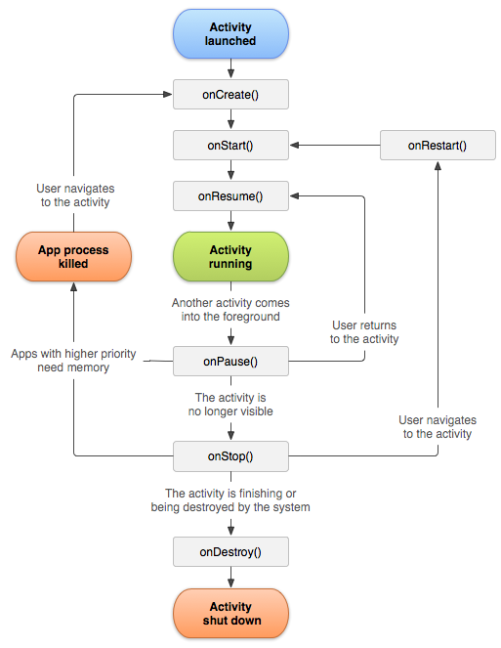
Activity-Lifecycle

Slide 9
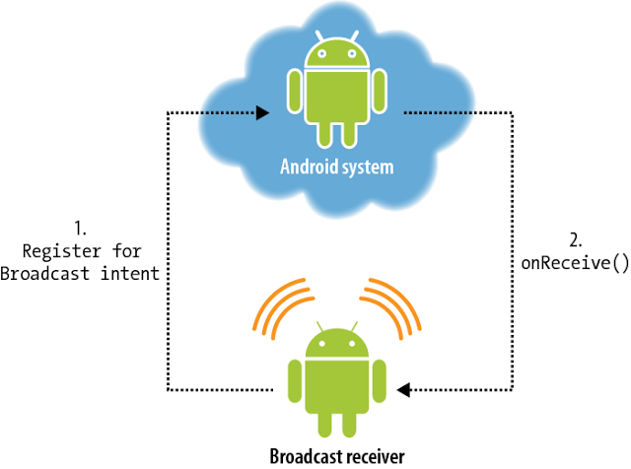
Broadcast Receiver

Slide 10
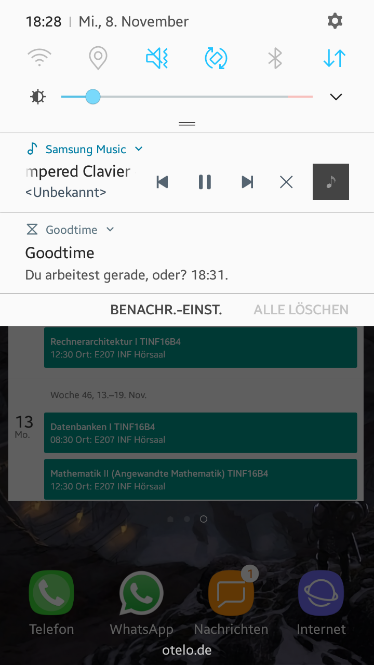
Services
Background Task
Can be started by from within an App
Can be bound by an App

Slide 11
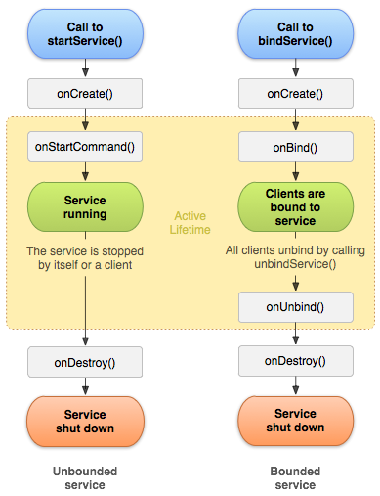
Services - Lifecycle

Slide 12
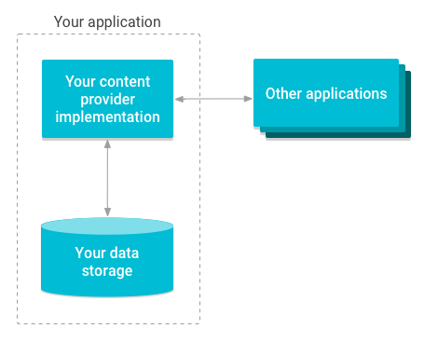
Content Provider
Managing App data
App data can be accesed by other Applications

Slide 13
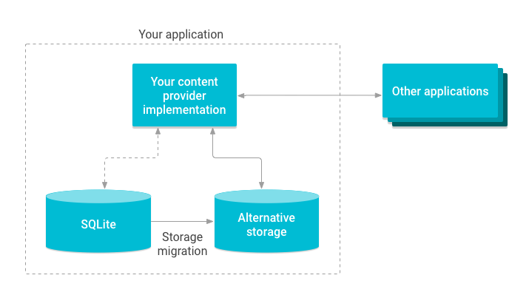
Content Provider
Managing data

Slide 14
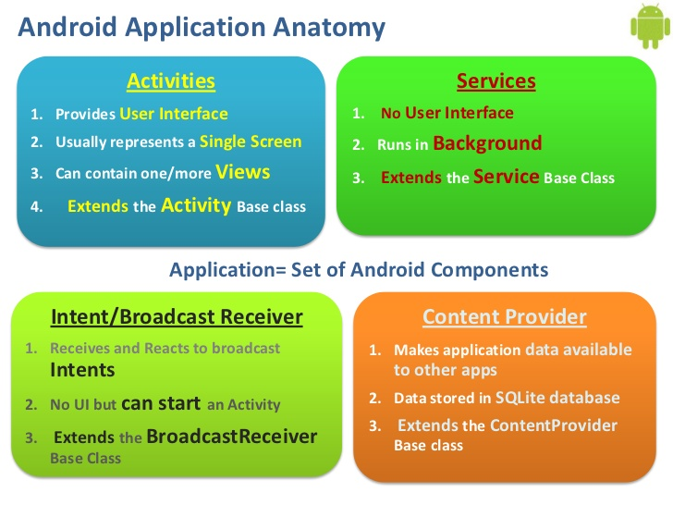
Android Application Anatomy

Slide 15
Resources

Slide 16
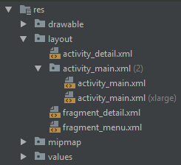
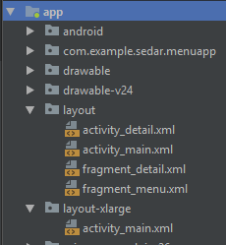
Resources
Pictures, Audio Files, Layouts etc. are saved in seperate directories
Qualifiers are used to offer different versions of the same resource.
Resources can be identified in the source code by their ID

Slide 17
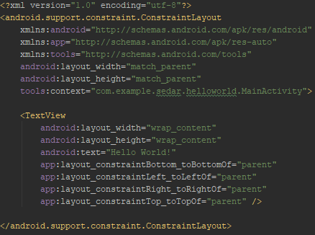
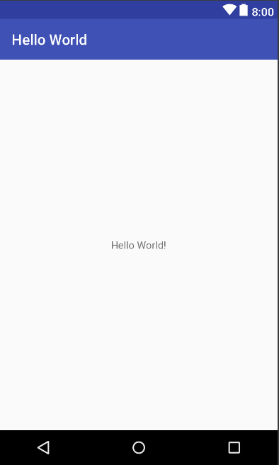
Layout
Android offers XML vocabulary to write layouts
Layouts are built by View and Viewgroup Objects

Slide 18
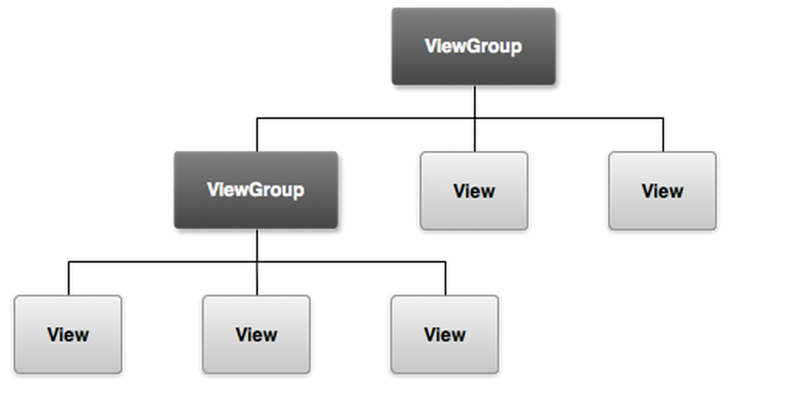
Layout

Slide 19
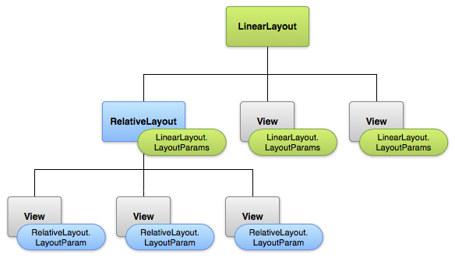
Layout

Slide 20
Fragments and Intents

Slide 21
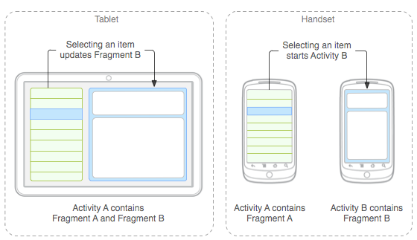
Fragments
Represents a portion of a user Interface in Activities
Modular component which has its own lifecycle
Can be added and removed while the Activity is running

Slide 22
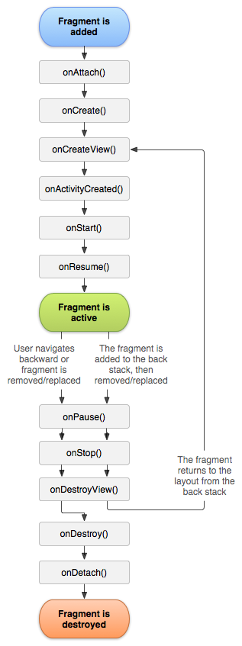
Fragments

Slide 23
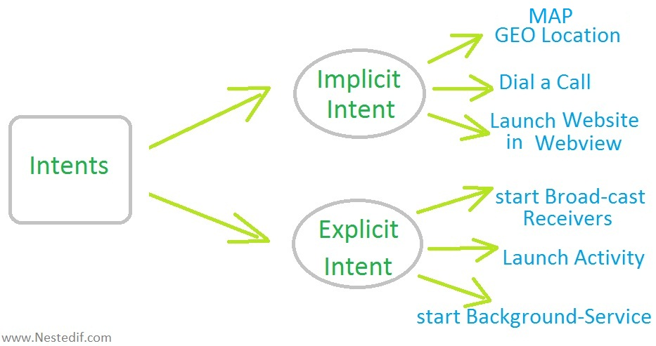
Intents
Messaging object for requesting an Action from another App Component
Two types of Intents: Implicit and Explicit

Slide 24
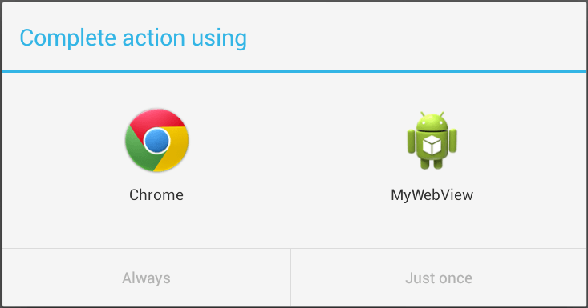
Implicit Intent

Slide 25
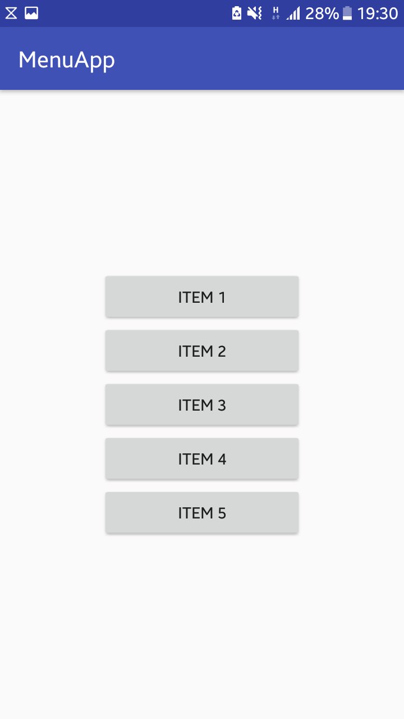
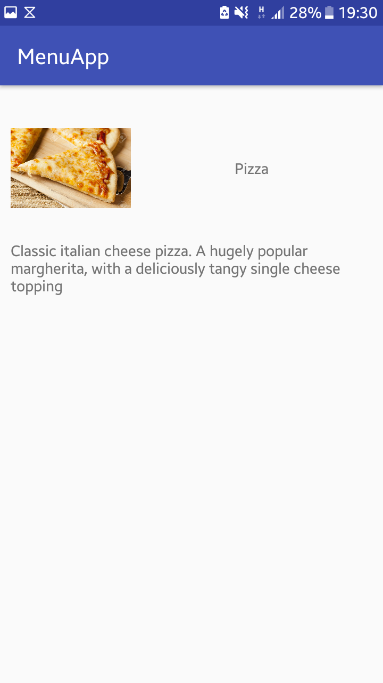
Explicit Intent

Slide 26
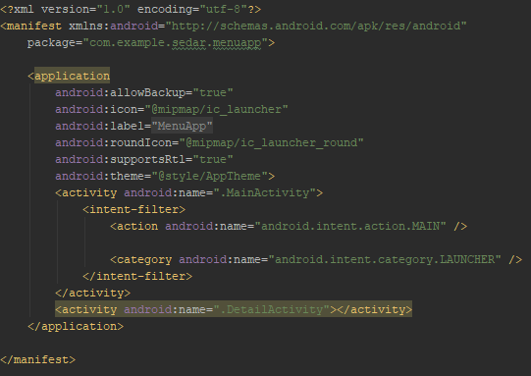
Android Manifest
Declares components of an App

Slide 27
MVC
Model
View
Application/Business Logic
Layout/Resources
Controller
Activity

Slide 28
Activating Debugging

Slide 29
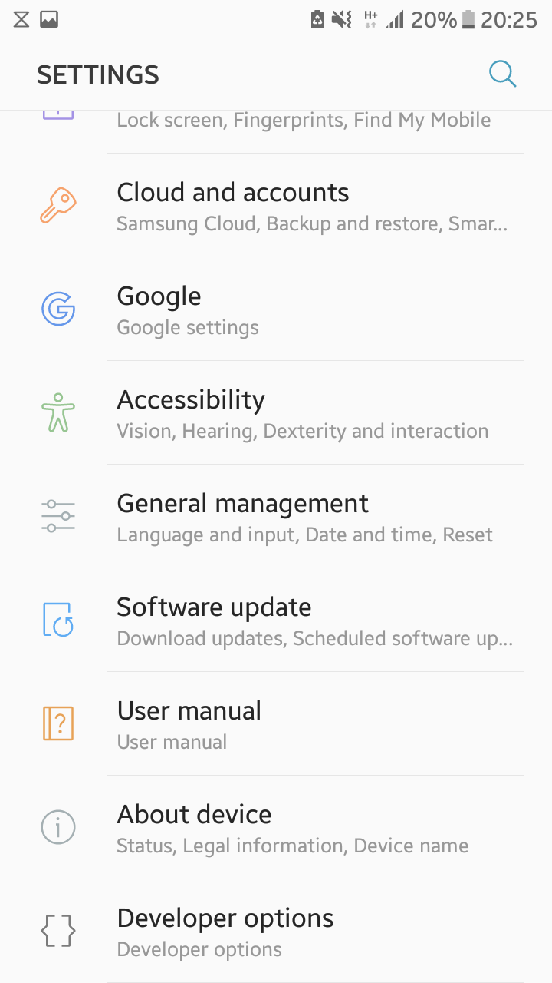
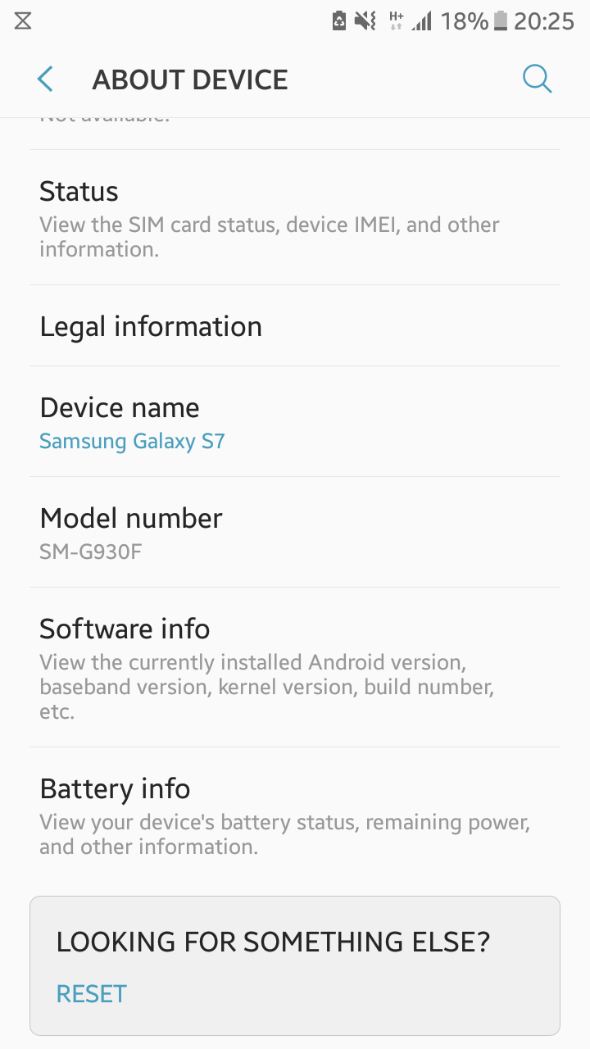
Activating - Developer Mode

Slide 30
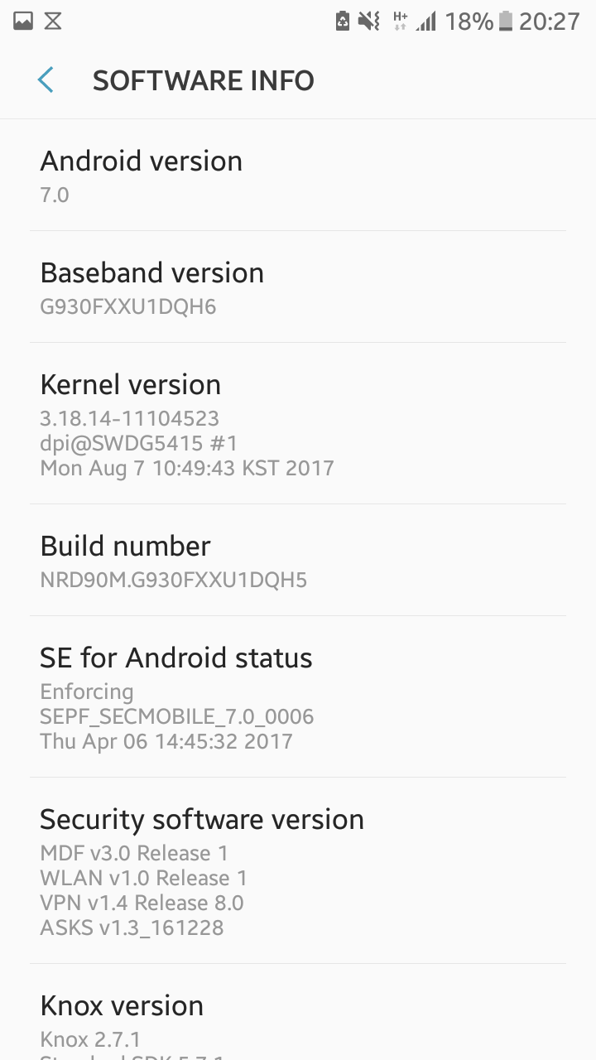
Activating - Developer Mode
Press 5 times

Slide 31
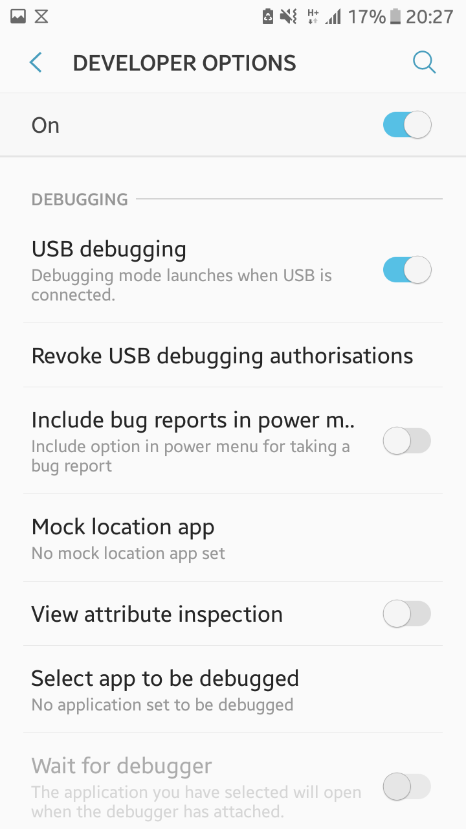
Activating - Debugging

Slide 32
Helpful Links
https://androiddevsguide.blogspot.de/2017/03/first-off-i-want-to-tell-people-what.html
https://www.tutorialspoint.com/android/
https://developer.android.com/index.html

